Slide 1
Cell Therapy for Spinal Cord Injuries: Commercial Manufacturing Facility
Rebecca J. Carlson and Ariel M. Rose
Chemical Engineering & Materials Science Michigan State University

Slide 2
Introduction
250,000 people in the US and over 440,000 people in Europe have a spinal cord injury (SCI)
Estimated lifetime costs per person are 1-5 million dollars
Goal: Produce neural stem cells (NSCs) for treatment of spinal cord injuries (SCIs)
  Production in US with possible expansion to Europe
National Spinal Cord Injury Statistical Center. (2012). Spinal cord injury facts and figures at a glance.

Slide 3
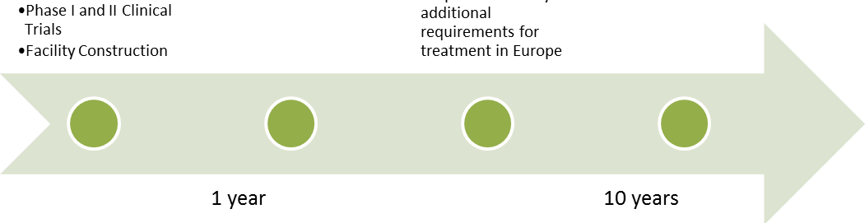
Proposed Timeline
2 years
Phase I/II clinical trials
Facility construction
10 years
US production
(3,000 doses/yr)
1 year
Phase III clinical trials (1,500 doses)
10 years
US and Europe production
(5,500 doses/yr)
Notes:
REMEMBER: mention 3000 doses/yr by determining fraction of people in the US likely to want/need the therapy

Slide 4

Ethically
Appropriate
High
Quality
Economically Competitive
Use of adult stem cell inoculum per problem statement
  Mesenchymal cells (MSCs) differentiated to neural stem cells (NSCs)
    No ethical issues
    May be used for allogeneic transplantation

Slide 5
Ethically
Appropriate
High
Quality
Economically Competitive
Safety: Layers of quality control
            Identity – surface markers
            Purity – detect viruses, bacteria
            Potency – verify differentiation
            Viability
            Cell number
            Biocompatibility
Quality Inspection
of Intermediate and Final Cell Cultures
Cells
Procedural Controls
Autoclaving
Aseptic handling
Disposable bioreactors
Controlled disposal systems
Virus filtration
Liquids
Disposable Reactors, Microcarriers
Validation
Raw Materials
Equipment
Cell Samples
Microcarriers
Quality inspection
cGMP-certified equipment and materials
Procurement
Notes:
Unidirectional flow, total 5045 ft2, reasonable size for facility with this number of treatments
Viruses with immunochromatographic test stripes, endotoxin with LAL assay, Gram stains, hemagglutination, cytopathic effects

Slide 6
Ethically
Appropriate
High
Quality
Economically Competitive
Safety: Proposed cGMP Facility Layout
Notes:
Unidirectional flow, total 5045 ft2, reasonable size for facility with this number of treatments

Slide 7
Ethically
Appropriate
High
Quality
Economically Competitive
ThawSTAR® system standardizes thawing
Notes:
Expansion lasts:

Slide 8
Ethically
Appropriate
High
Quality
Economically Competitive
All inputs cGMP-certified
Serum-free, xeno-free materials
Filtration
Notes:
Expansion lasts:

Slide 9
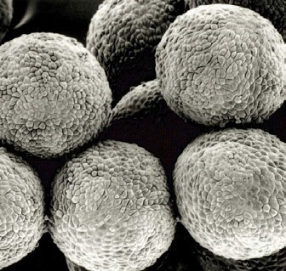
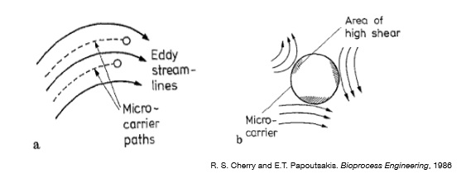
Ethically
Appropriate
High
Quality
Economically Competitive
Pall SoloHill Plastic Plus optimal microcarrier
        Non-xenogeneic
        Withstand autoclaving
        Relatively inexpensive
        High cell attachment (even in FBS-free media)
        Lack of micropores allows easy detachment
        Available in small diameters
          Cells experience minimal shear force as long as Kolmogorov eddy length >1/2D_{microcarrier}
http://ru.pall.com/main/biopharmaceuticals/bioprocess-vision-issue.page
Notes:
http://ru.pall.com/main/biopharmaceuticals/bioprocess-vision-issue.page
Dmicrocarrier is 120um, verified Kolmogorov at least 60um for all runs

Slide 10
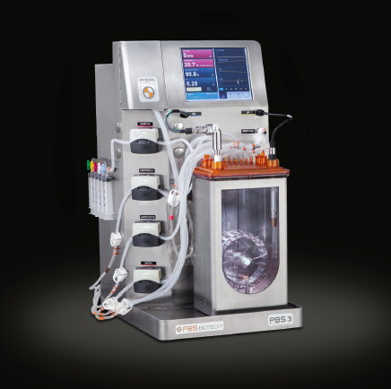
Ethically
Appropriate
High
Quality
Economically Competitive
PBS Biotech Vertical Wheel Bioreactor
  Vertical wheel minimizes shear stress
  Already optimized for MSC culture
  Scalable
  Accommodates microcarriers
Bioreactor conditions
  Higher proliferation under hypoxic conditions
  Differentiate with EGF and FGF2 growth factors
  Better differentiation at 32°C
  Passage by detaching cells from microcarriers at high agitation
  Final separation: xeno-free trypsinization
http://www.pbsbiotech.com/pbs-3.html
Notes:
Do we want to talk more about detachment?
Expansion lasts: 10 days in T75, 7 days each in 0.1 L, 0.5 L, 3, 15, and 80 L reactors
3 parallel trains up to and including 0.5 L in case of contamination or subpar growth
Assume exponential growth, doubling time of 62.4 hours in bioreactors, 200hrs in T75 flasks

Slide 11

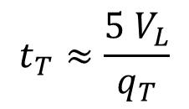
Ethically
Appropriate
High
Quality
Economically Competitive
Bioreactor Performance
    Shear stress:
        All calculated less than 4 dyn/cm², MSC differentiation not induced until 15 dyn/cm²
    Mixing time:
        All mixing times under 17s
$$τ_{max}=5.33∗ρ_{f}∗{\left(ν∗ε\right)}^{1/2}$$
$$t_{T}≈\frac{5 V_{L}}{q_{T}}$$
Notes:
http://ru.pall.com/main/biopharmaceuticals/bioprocess-vision-issue.page
Nu kinematic viscosity believe used paper, epsilon is power per unit mass

Slide 12


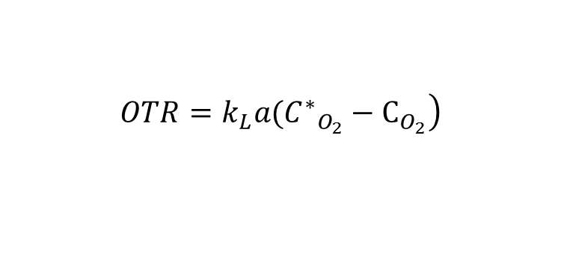
Ethically
Appropriate
High
Quality
Economically Competitive
Bioreactor Performance
    Oxygen mass transfer:
        Calculated maximum viable cell density greater than actual in all cases
$$\left.OTR=k_{L}a({C^{∗}}_{O_{2}}−C_{O_{2}}\right)$$
$$sOUR=\frac{q_{O_{2}}}{V_{L}}$$
$${VCD}_{max}=\frac{OTR}{sOUR}$$
Notes:
Sour is g o2/cell/hr
Otr = g o2/l/hr

Slide 13
Ethically
Appropriate
High
Quality
Economically Competitive
Fluidized bed centrifugation removes microcarriers, washes, and concentrates cells in one step

Slide 14
Ethically
Appropriate
High
Quality
Economically Competitive
Magnetic-activated cell sorting (MACS):
High-throughput
Low-cost
Low processing times
Does not require single-cell suspension
Notes:
Low processing of 3 hrs relative to FACS but yield only about 60%. Low processing increases recovery, viability.

Slide 15
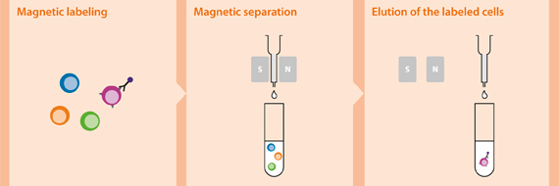
Ethically
Appropriate
High
Quality
Economically Competitive
Negative Selection with MACS Separation
Labeled cells: Undifferentiated MSCs (CD166^{hi}, CD44^{hi}, CD105^{hi})
Unlabeled cells: NSCs
Notes:
Low processing of 3 hrs relative to FACS but yield only about 60%. Low processing increases recovery, viability.

Slide 16
Ethically
Appropriate
High
Quality
Economically Competitive
Labeling and freezing:
Vials with pre-labeled barcodes
Automatic vial filler
Controlled rate freezing
Notes:
Fill it vial filler, 10% DMSO

Slide 17
Ethically
Appropriate
High
Quality
Economically Competitive
Equipment and Fixed Capital Investment
Estimated equipment cost - $2.1M ($1.51M average for same-size facility)
  Majority of cost from bioreactors, additional equipment (mainly tanks), kSep centrifugation
Total capital cost - $36M, working capital is $7.2M
Notes:
Additional: filter integrity tester, autoclave, waste tanks, vessels for media and buffer preparation

Slide 18
Ethically
Appropriate
High
Quality
Economically Competitive
Manufacturing Costs
$32.1M/yr for US operations, direct cost of $5,380/dose (compared to estimate of $1,890 in literature)
Notes:
Additional: filter integrity tester, autoclave, waste tanks, vessels for media and buffer preparation

Slide 19
Ethically
Appropriate
High
Quality
Economically Competitive
Profitability
Used MACRS depreciation rates, took into account cost of clinical trials
Suggested $40,000/dose (low compared to suggested price of $500,000 for cell therapies at this scale)
 | US Project | US and European Project
IRR | 55.99% | 56.23%
Net Present Worth (NPW) | $553,960,000 | $1,726,990,000
Price per Dose Yielding 50% IRR | $35,364 | $34,975
Notes:
Expansion to Europe likely not worth it unless done earlier (equipment replacement at 10years). Also not considered here is simply obsolence of technology

Slide 20
Ethically
Appropriate
High
Quality
Economically Competitive
Sensitivity Analysis
Notes:
A sensitivity analysis was performed on six key process costs (Figure 25, detailed results in Appendix M). Based on the analysis, changes in fixed equipment cost had the larges impact on net present worth, largely due to the many multipliers that result in an estimate of total fixed capital investment as a function of the equipment purchased cost. Next, the percentage change in proliferation media cost and the fixed manufacturing costs had a large effect on NPW. This means that, since the price used for the media was not a bulk estimate, the NPW is likely much higher than estimated in the report. Fortunately, although the cost for clinical trials was only an approximate estimate, percentage changes in this cost have a fairly small effect on NPW.

Slide 21
Ethically
Appropriate
High
Quality
Economically Competitive
Optimization
Media change frequency – at maximum cell density, must change every 2 hours
Notes:
Additional: filter integrity tester, autoclave, waste tanks, vessels for media and buffer preparation

Slide 22
Ethically
Appropriate
High
Quality
Economically Competitive
Optimization
Optimization Step | Yearly Savings | % ROI Savings | Cumulative % ROI Savings
Prelabeled tubes | NA | 2.5% | 2.52%
PBS buffer formulation onsite | $5,210 | 0.02% | 2.54%
Proliferation media selection | $13,209,000 | 22.8% | 25.3%
Media change frequency | $4,479,000 | 12.7% | 38.0%
Notes:
Additional: filter integrity tester, autoclave, waste tanks, vessels for media and buffer preparation

Slide 23
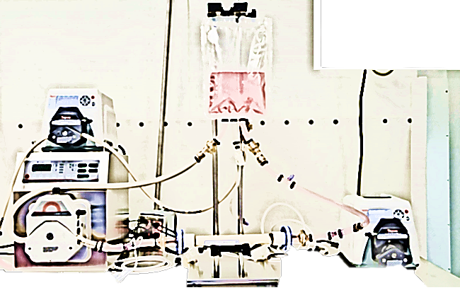
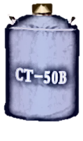
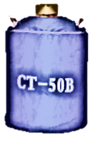
Ethically
Appropriate
High
Quality
Economically Competitive
Other Optimizations Considered
Tangential Flow Filtration – cheaper than FBC for processes at similar number of doses, cells/dose
  Device from Lonza not yet available for purchase commercially
Liquid Nitrogen Generation Onsite – 3.9% ROI loss
  Could be reconsidered with more precise LN₂ consumption estimates
Notes:
Additional: filter integrity tester, autoclave, waste tanks, vessels for media and buffer preparation

Slide 24
Conclusions and Recommendations
Cell Therapy Process
Achieved 3 Key Objectives:
Future Recommendations
Further study of novel therapy
  Client base
  Efficacy
  Growth Dynamics
  Differentiation Efficiency
  Business Model
Target identified losses
Ethically
Appropriate
High
Quality
Economically Competitive
Cell Losses

Slide 25
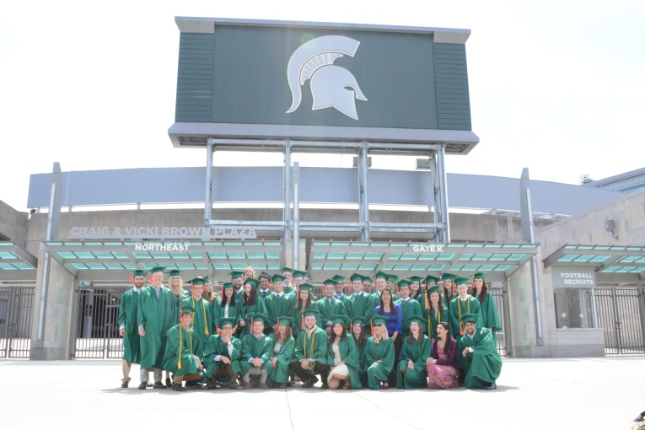
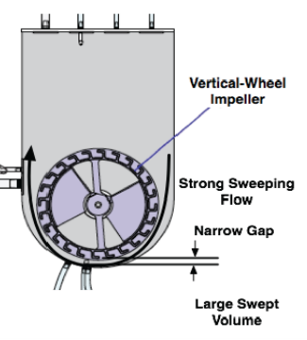
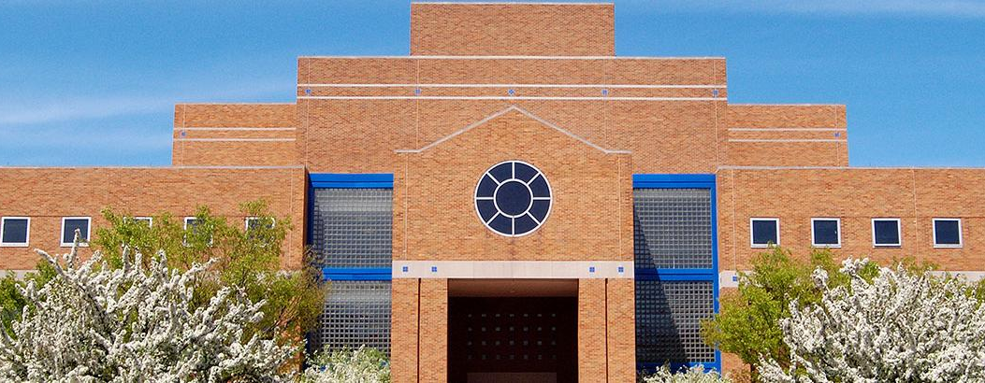



















Acknowledgments
Industry representatives (time, resources, expertise)
Michigan State University Chemical Engineering and Materials Science department (training, support)
God and family (sustenance and encouragement)

Slide 26
Questions?

